Slide 1

Spring JDBC
Dima Ionut Daniel

Slide 2
Contents
What is Spring JDBC?
Overview
Spring JDBC Core
SQL Exceptions
Database Connection
Batch Operations
Handling BLOB/CLOB
Embedded Database
Conclusions
Bibliography

Slide 3

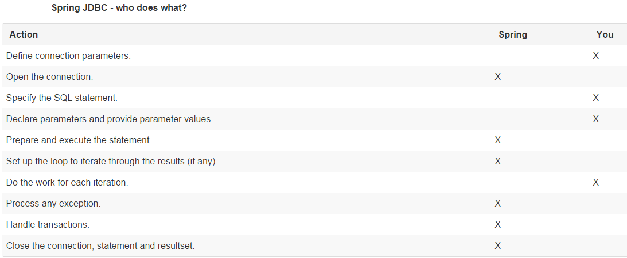
What is Spring JDBC?
Spring JDBC is an abstraction framework for JDBC that provides easier access to datasources without all the exception handling and parsing of SQL fetch results.

Slide 4
Overview
Usefull classes: JdbcTemplate, SimpleJdbcInsert, SimpleJdbcCall that requires a JDBC 2.0 compliant driver and some advanced features require a JDBC 3.0 driver.
JdbcTemplate is the classic Spring JDBC approach and the most popular.
SimpleJdbcInsert and SimpleJdbcCall optimize database metadata to limit the amount of necessary configuration.
NamedParameterJdbcTemplate wraps a JdbcTemplate to provide named parameters instead of the traditional JDBC "?" placeholders.
RDBMS Objects including MappingSqlQuery, SqlUpdate and StoredProcedure requires you to create reusable and thread-safe objects during initialization of your data access layer.

Slide 5
Overview (cont.)
The Spring Framework’s JDBC abstraction framework consists of four different packages: core, datasource, object, and support.
The org.springframework.jdbc.core package contains the JdbcTemplate class and its various callback interfaces, plus a variety of related classes.
The subpackage named org.springframework.jdbc.core.simple contains the SimpleJdbcInsert and SimpleJdbcCall classes.
The subpackage named org.springframework.jdbc.core.namedparam contains the NamedParameterJdbcTemplate class and the related support classes.
The subpackage named org.springfamework.jdbc.datasource.embedded provides support for creating in-memory database instances using Java database engines such as HSQL and H2.
The org.springframework.jdbc.support package provides SQLException translation functionality and some utility classes.

Slide 6
Spring JDBC Core
The JdbcTemplate class is the central class in the JDBC core package and handles the creation and release of resources.
The JdbcTemplate class executes SQL queries, update statements and stored procedure calls, performs iteration over ResultSets and extraction of returned parameter values.
It also catches JDBC exceptions and translates them to the generic, more informative, exception hierarchy defined in te org.springframework.dao package.
The PreparedStatementCreator or CallableStatementCreator callback interfaces creates a prepared/callback statement given a Connection provided.
The RowCallbackHandler interface extracts values from each row of a ResultSet.

Slide 7
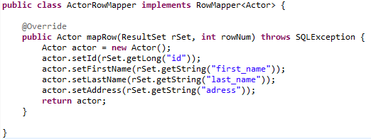
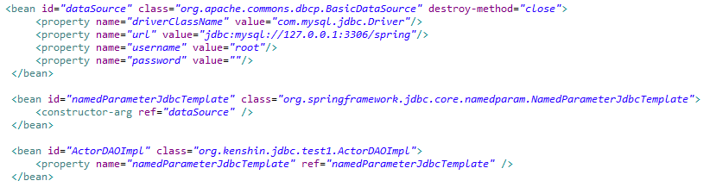
Spring JDBC Core (cont.)
The NamedParamterJdbcTemplate needs a datasource.
The RowMapper interface is used to map(iterate) a line from the ResultSet to domain bean.

Slide 8
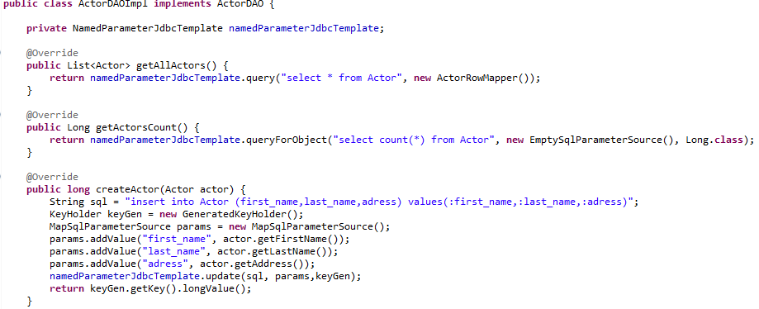
Spring JDBC Core (cont.)
The NamedParamterTemplate can be used for CRUD JDBC operations.
KeyHolder/GeneratedKeyHolder can be used to retrieve auto generated values from the RDBMS.

Slide 9
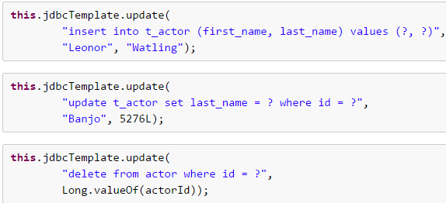
Spring JDBC Core (cont.)
The JdbcTemplate has an update() method that can perform insert, update, delete operations.
Parameter values are usually provided as var args or alternatively as an object array.

Slide 10

Spring JDBC Core (cont.)
The JdbcTemplate has the execute() method that can execute arbitrary SQL like DDL statements.
It is heavily overloaded with variants taking callback interfaces, binding variable arrays
Instances of the JdbcTemplate class are threadsafe once configured.
This is important because it means that you can configure a single instance of a JdbcTemplate and then safely inject this shared reference into multiple DAOs (or repositories).
The JdbcTemplate is stateful, in that it maintains a reference to a DataSource, but this state is not conversational state.

Slide 11
SQL Exceptions
SQLExceptionTranslator is an interface to be implemented by classes that can translate between SQLExceptions and Spring’s own org.springframework.dao.DataAccessException
Implementations can be generic (for example, using SQLState codes for JDBC) or proprietary (for example, using Oracle error codes) for greater precision.
SQLErrorCodeSQLExceptionTranslator is the implementation of SQLExceptionTranslator that is used by default.

Slide 12
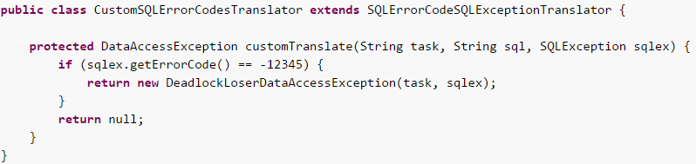
SQL Exceptions (cont.)
The error code translations are based on codes held in a JavaBean type class called SQLErrorCodes.
This class is created and populated by an SQLErrorCodesFactory which as the name suggests is a factory for creating SQLErrorCodes based on the contents of a configuration file named sql-error-codes.xml.
This file is populated with vendor codes and based on the DatabaseProductName taken from the DatabaseMetaData.

Slide 13
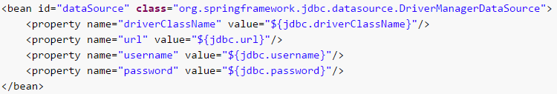
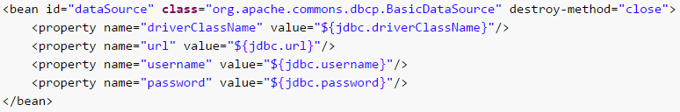
Database Connection
Spring obtains a connection to the database through a DataSource.
Popular connection pool implementations are Apache Jakarta Commons DBCP and C3P0.
Spring provides DriverManagerDataSource from org.springframework.jdbc.datasource package.
BasicDataSource sample usage:

Slide 14
Database Connection (cont.)
The SmartDataSource interface should be implemented by classes that can provide a connection to a relational database.
The SingleConnectionDataSource class is an implementation of the SmartDataSource interface that wraps a single Connection that is not closed after each use.
The DataSourceTransactionManager class is a PlatformTransactionManager implementation for single JDBC datasources.
It binds a JDBC connection from the specified data source to the currently executing thread, potentially allowing for one thread connection per data source.

Slide 15
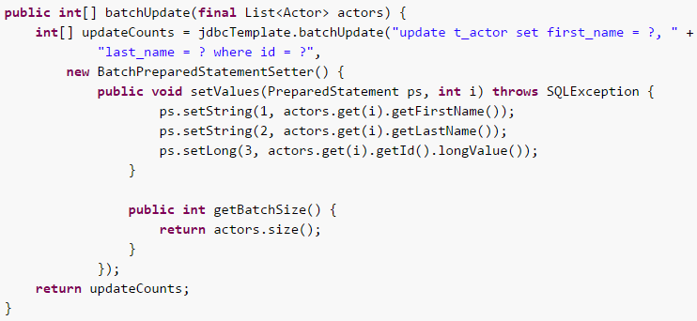
Batch Operations
BatchPreparedStatementSetter can be used to pass parameters during a batch update method call.
We use the getBatchSize method to provide the size of the current batch.
We use the setValues method to set the values for the parameters of the prepared statement.
This method will be called the number of times that you specified in the getBatchSize call.

Slide 16
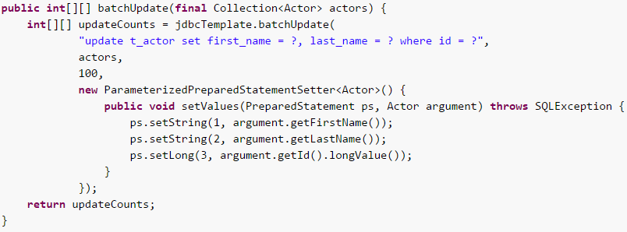
Batch Operations (cont.)
ParameterizedPreparedStatementSetter can also be used in the batch operations.

Slide 17
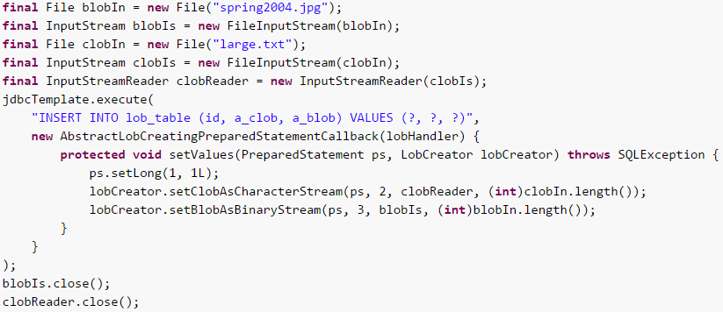
Handling BLOB/CLOB
In Spring you can handle these large objects by using the JdbcTemplate directly.
We can use also implementation of LobHandler for the actual management of the LOB data.
The LobHandler provides access to a LobCreator class, through the getLobCreator method, used for creating new LOB objects to be inserted.

Slide 18

Embedded Database
The org.springframework.jdbc.datasource.embedded package provides support for embedded Java database engines.
Support for HSQL, H2, and Derby is provided natively.
We can also use an extensible API to plug in new embedded database types and DataSource implementations.
The EmbeddedDatabaseBuilder class provides a fluent API for constructing an embedded database programmatically.

Slide 19
Conclusions
Spring JDBC is very useful to use when working with RDBMS.
Spring JDBC is documented.
Spring JDBC is easy to use.

Slide 20

Bibliography
http://docs.spring.io/spring-framework/docs/current/spring-framework-reference/html/jdbc.html

